Slide 1
Pb²
Typing Assistant for a computer driven world

Slide 2
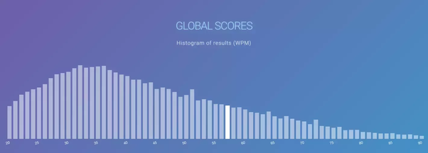
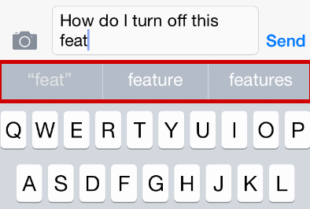
The World Needs a Writing Assistant
Average Typing speed in the US 40 WPM
Limits ability to use Computer
Creates a gulf among users
Browsers Are the hub of modern computer use
Make it easier to use computers

Slide 3
Goals
Incorporate the Mobile Phone Suggested word feature into

Slide 4
Bibliography
Typing Speed Test
Iphone FAQ

